Slide 1

Trip Assistant New York
Presented By:
Kritin Kondru
Wiki url: https://github.com/kritkondru/TripAssistantNewYork/wiki
Github url:https://github.com/kritkondru/TripAssistantNewYork
Video url: https://www.youtube.com/watch?v=1UKfIkANHGc&feature=youtu.be&hd=1

Slide 2
Description of the problem
While going through many websites and blogs we have found that people love to travel to exotic destinations .
Based on this we have decided to create “TRIP ASSISTANT NEW YORK”.
Trip assistant app allows users to plan their trip to New York.
There are various problems which are faced by new travelers like the best mode to reach to any place, famous restaurants, stay and rentals, average cost per day per person, share the trip information to other friends via email or other sharing apps.
Hence our app lets the users to plan their trip accordingly .

Slide 3
Research about the app
Before developing the app we have gone through few app’s like trip advisor ,Trip Planner ,Road Atlas ,Expedia and Thomas cook.
We had found that these apps do not provide details like closest restaurant ,best means of transport to get to any location and average cost it would take for person per day to travel ,eat and sleep .
So we have emphasized on these matters and developed “TRIP ASSISTANT NEW YORK”.

Slide 4
Description of the users
Our app caters to people who want to travel to NEW YORK.
We concentrate on all groups of people who desire to come to visit this place by providing them options of Accommodation ranging from a couple hundred dollars to few hundred dollars ,which helps people on a budget too to plan a trip.
We also share the entire details of the restaurants and Accommodation that are mentioned in the app by providing a link to their portals .

Slide 5
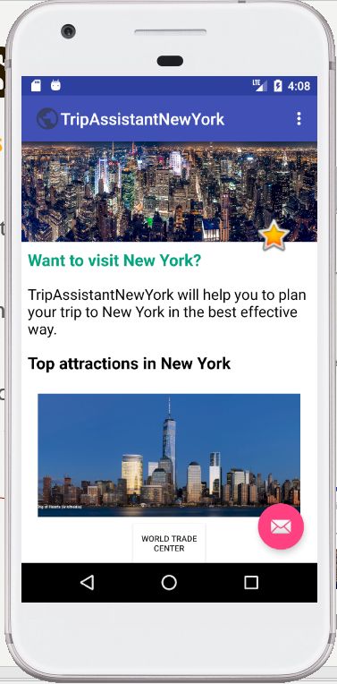
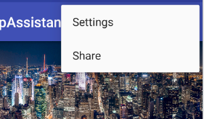
Features of the app
Our app provides the following features
1.Top attractions to visit in NEW YORK.
2.It also provides the Image and name of destination.
3.We have also provided a share option which when
clicked allows the user to share the page on g-mail or
message.

Slide 6
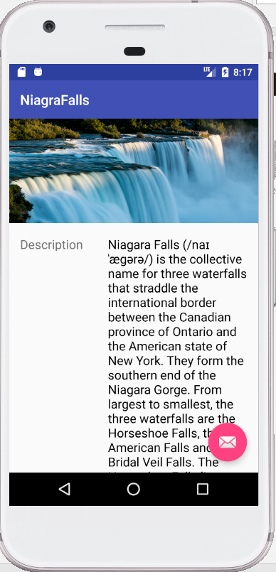
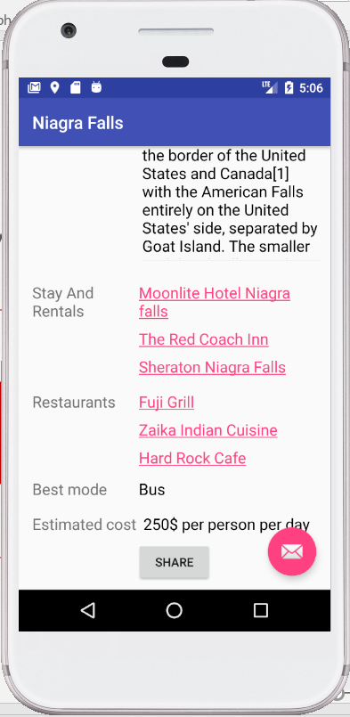
Features of the app
4.On clicking the button of any attraction we get redirected to another page which gives us details such as :
Description
Stay & Rentals
Restaurants
Best Mode
Estimated Cost
Links to the respective
restaurants and rentals
Share

Slide 7

Technology that was used
We have used android studio to develop the app
Our min SDK version:23 and target SDK version:27

Slide 8
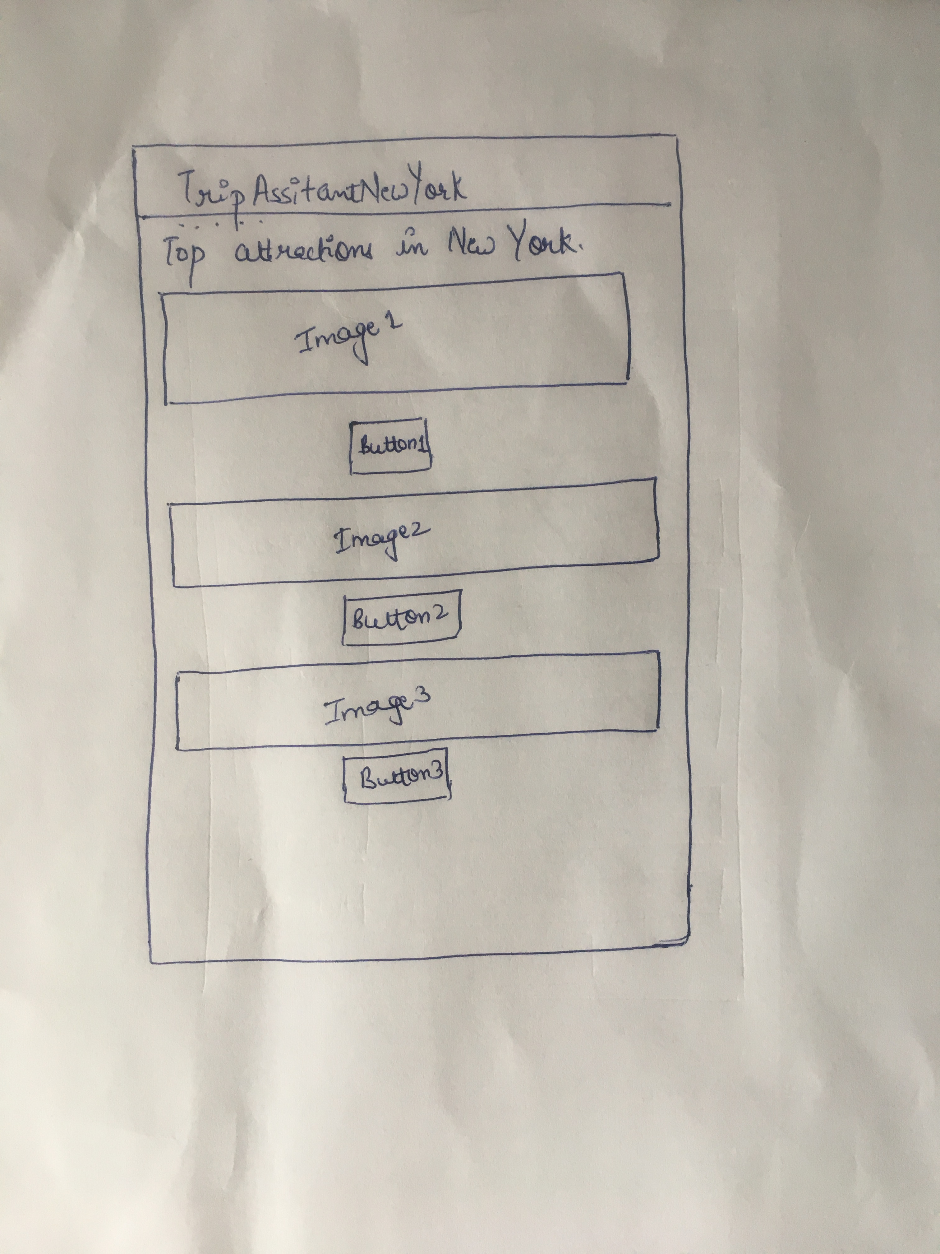
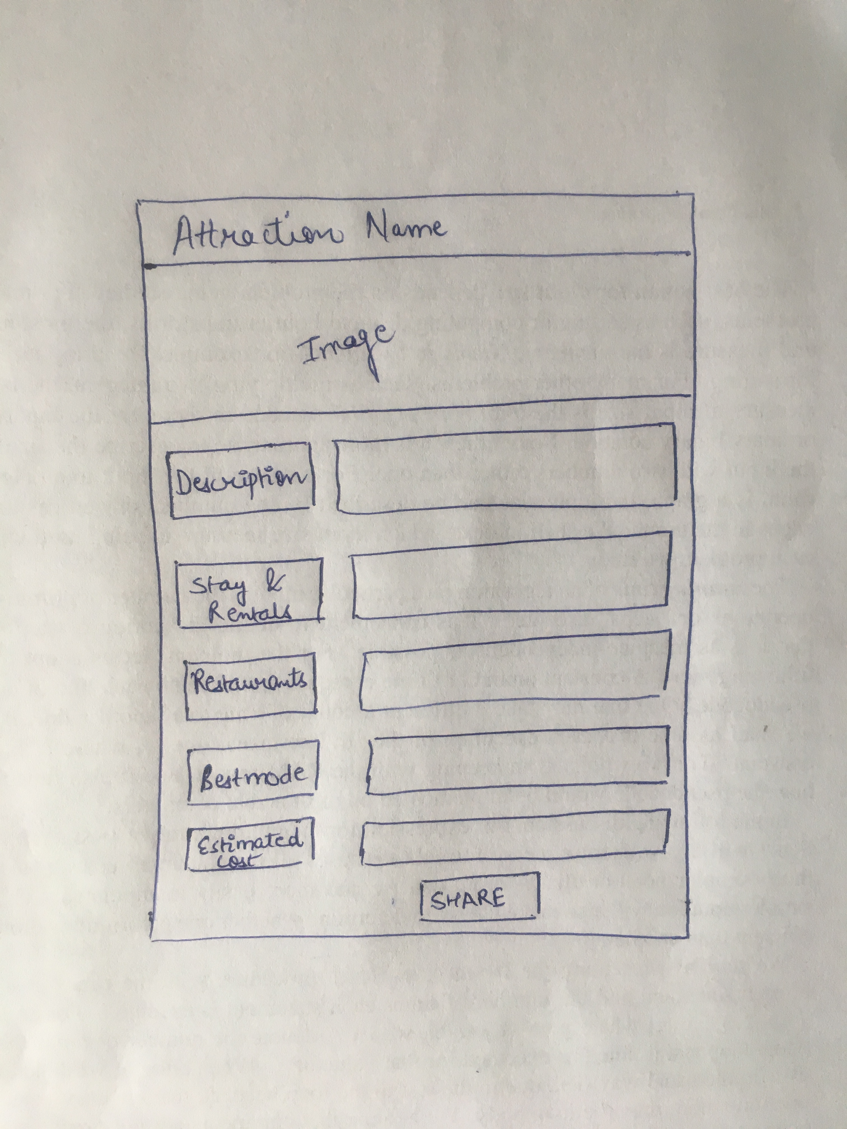
Pen & Paper Ui

Slide 9
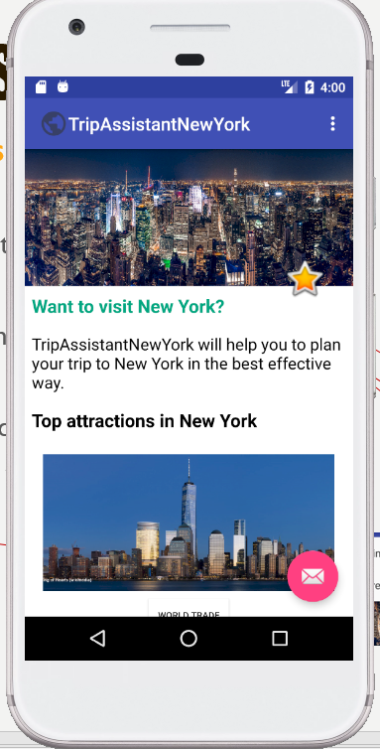
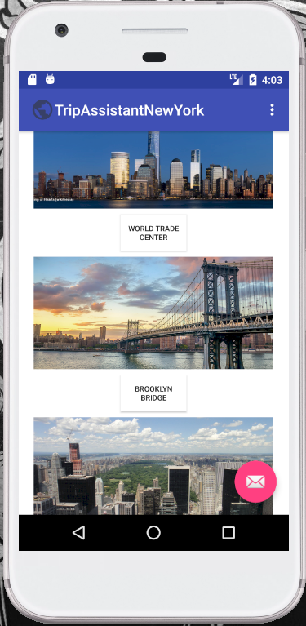
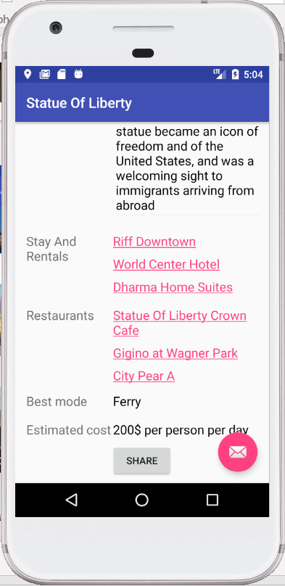
screenshots
Home Page
Home Page
Attraction Page
Attraction Page
Video Link: https://www.youtube.com/watch?v=1UKfIkANHGc&feature=youtu.be&hd=1

Slide 10
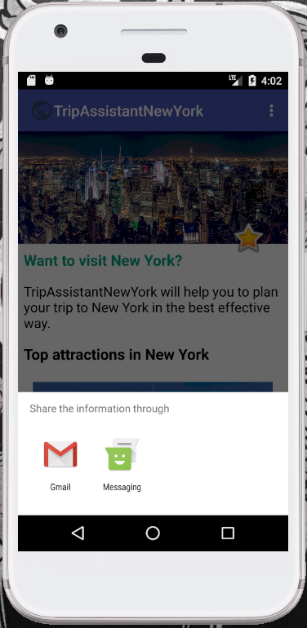
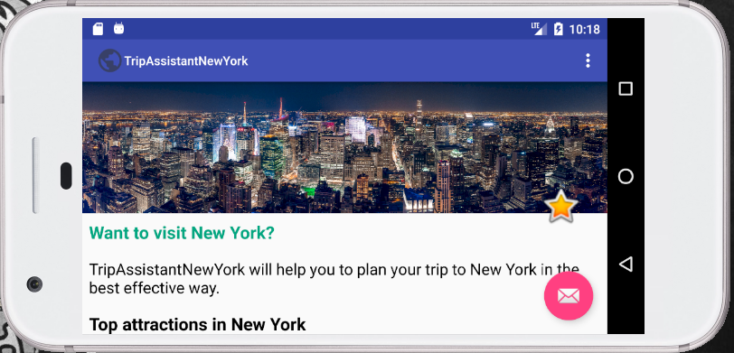
screenshots
onOptionsItemSelected(MenuItem item)
Sharing options
Home Page View in Landscape

Slide 11
Status of the development of the app
At the beginning when developing prototype there were a few errors that had to be addressed like constraints ,layouts used and connection to firebase.
Connecting to firebase has been a bit hard and we were not successful in doing so.
But once the other errors were dealt with , the app Is working without any errors.

Slide 12
Problems encountered
Oh God Help Me!!!!!!
At the beginning while developing layout some constraints weren’t working as intended.
We were unable to connect the app to firebase.
Pushing and pulling from GitHub proved a bit difficult since wee had to force update some times due to which we could not see how many commits each of us made .

Slide 13

Thank You
Happy Holidays
And
Safe Travel

